Slide 1
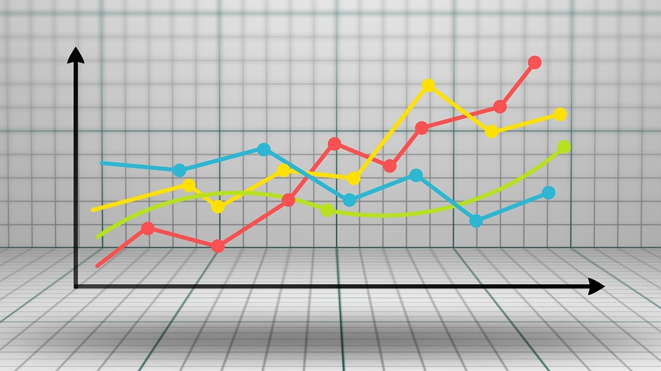
GOLD PRICE FORECASTING
By:-
Miss.Vaishnavi Mande
Mr.Mayur Mapari
Mr.Aniket Mali
Mr.Pravin Shende
Mr.Nayan Kumar
Mentor:- Karthik Muskula Date:-25/08/2022

Slide 2
BUSINESS OBJECTIVE
The objective is to understand the underlying structure in our dataset and to make the suitable forecasting model which can effectively forecast gold prices for next 30 days.
So that this forecast model will be used by gold exporting and gold importing companies to understand the metal price movements and accordingly set their revenue expectations.

Slide 3
PROJECT FLOW
These are the steps which we will follow while building forecasting model:
EDA & Data Visualization
Model Building
Model Evaluation
Model Deployment
EDA will help to understand the nature, trend , duplication, missing values in the dataset.
For forecasting purpose there are many model driven & data driven techniques so we will apply all these techniques on the Gold datset.
Using different metrics , we will evaluate different models & try to reach one for best one.
Using Streamlit library , we will Deploy our model for Service purpose.

Slide 4
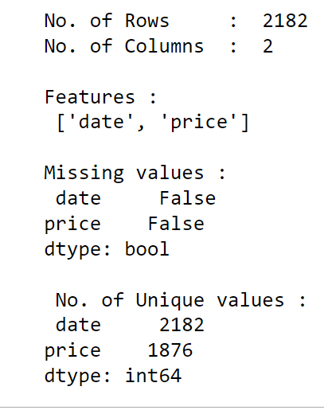
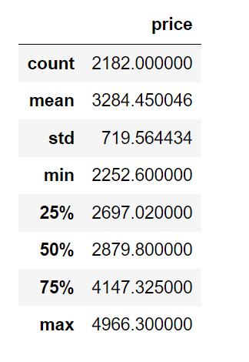
GOLD PRICE DATASET INFORMATION:
Description of Gold Price dataset:
This chart shows the basic information related to dataset:

Slide 5
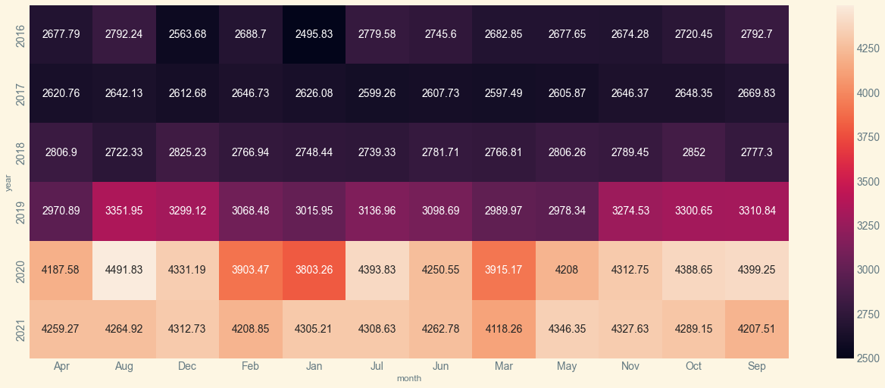
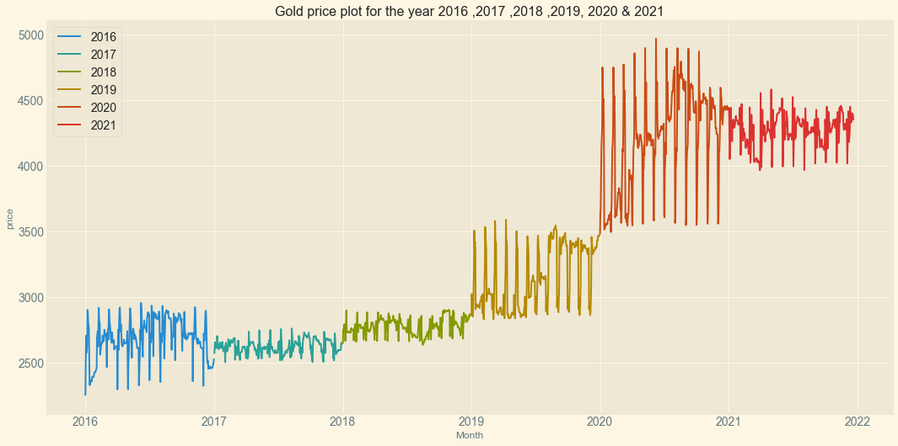
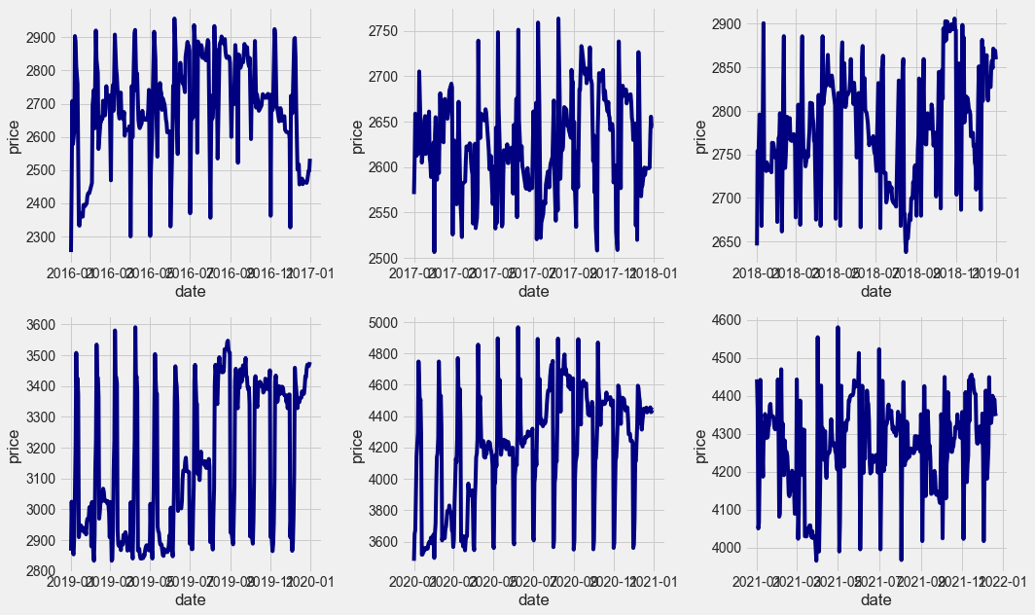
EDA AND DATA VISUALIZATION:
This heatmap shows the correlation of prices between Month & Year:
Overall Projection of the Gold Prices:
Yearwise trend of Gold Prices:

Slide 6
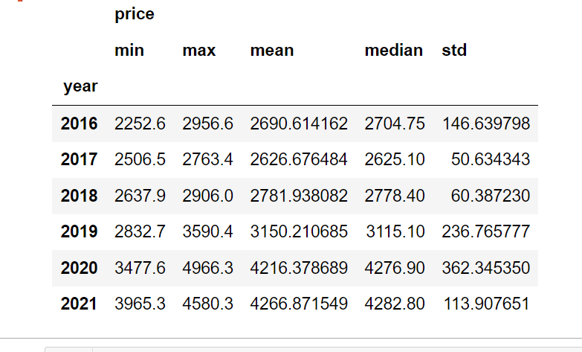
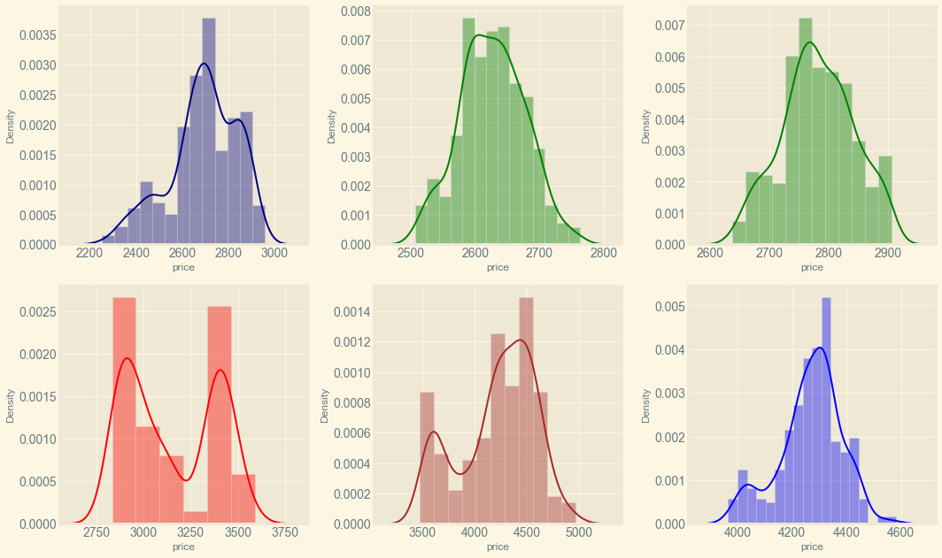
EXPLORATORY DATA ANALYSIS:
Yearwise Price Analysis :
Yearwise Distribution Plots of Gold Prices:
Prices of Gold for year 2017 & 2018 are normally distributed
But
For year 2019 & 2020 prices doesn’t shows proper distribution . This period basically belongs to Covid Pandemic.
Year 2020 shows the higest variation in prices & max. price reached in that year.
While year 2017 & 2018 shows less variation in prices.
Mean price value of year 2017 shows decreasing trend but later for each year trend is upward.

Slide 7
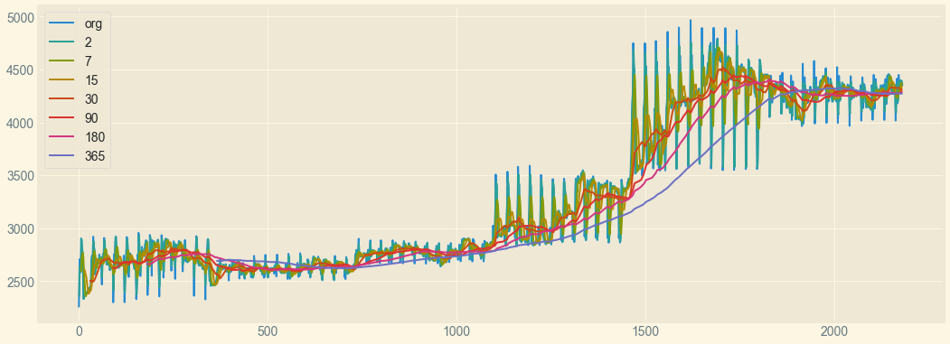
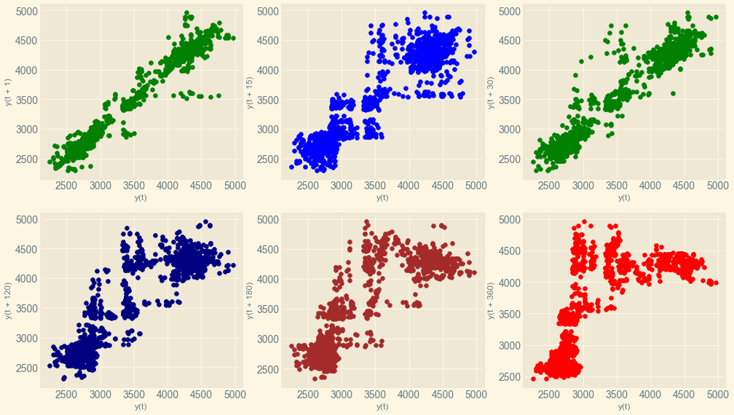
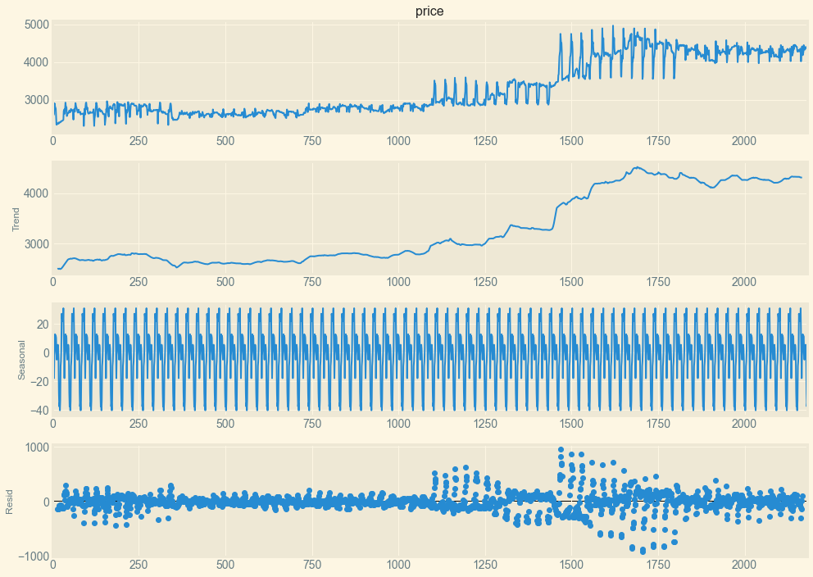
Graphs of prices using Moving Avg. function are drawn for different periods.
Plot for period of 30 days shows smooth nature as well as gives less residual with comparision to period values.
Lag_plots :
Different lag plots are drawn for different period to see the correlation between values.
Lag plot of period 1 & 30 days shows higer correlation .
This plot helps to find out the seasonality in data .
This Gold price data shown monthly seasonality.
Seasonal Decomposition Graphs:
Seasonal decomposition graph for period 30 days is drawn . Thus graph shows proper seasonal trend for 30 days period.

Slide 8
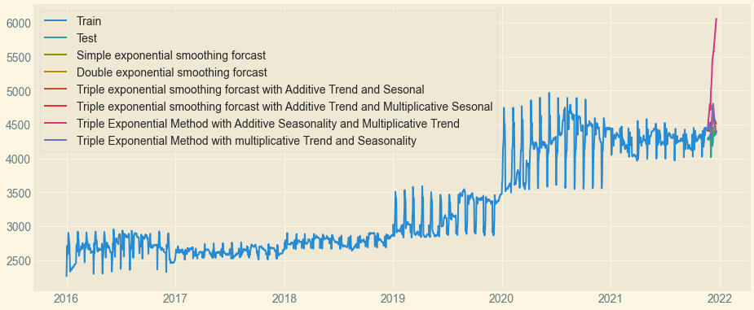
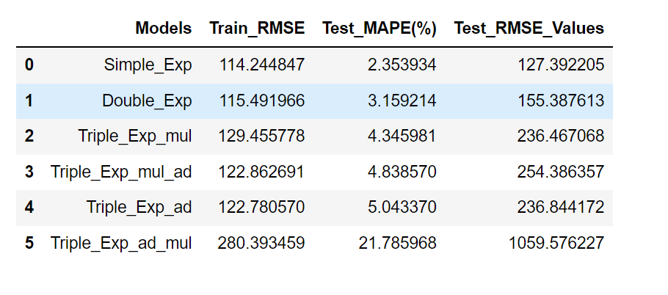
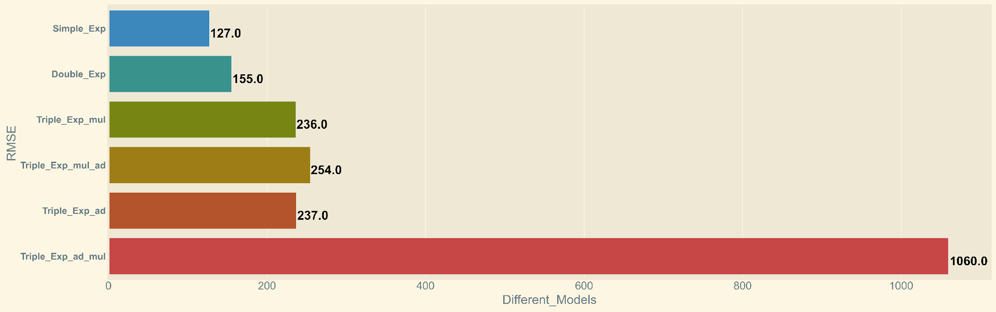
Model Evaluation:
Observations:
Simple exponential fuction gives the lowest RMSE values but it doesn’t captures the trend and seasonality.
Double exponential model is better one but it captures only the trend but not seasonality.
So we will look for Arima & Sarima models.
This is visual plot of the RMSE values tested for validation dataset.
Visulisation gives better comparative result between the different models.

Slide 9
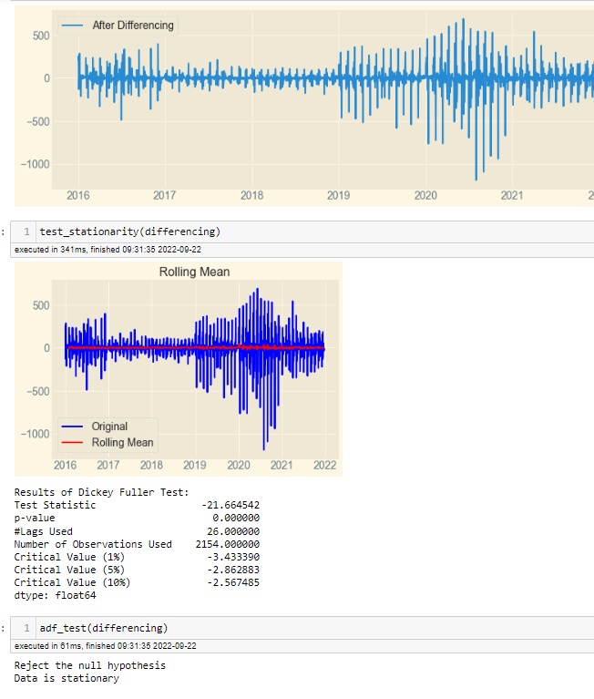
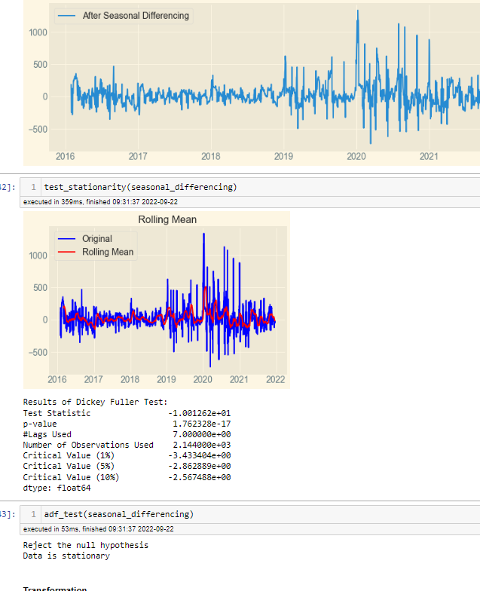
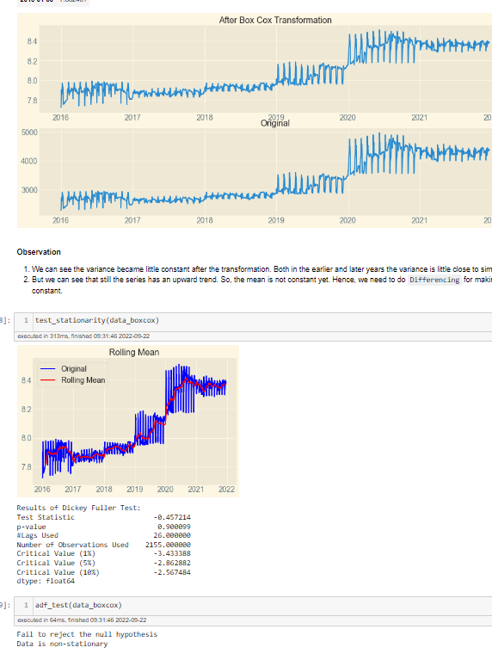
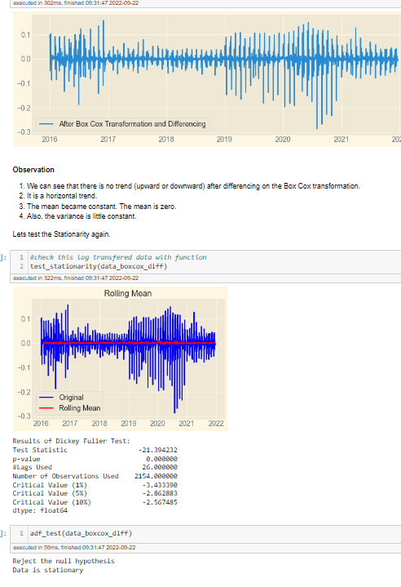
Different Techniques For Making Data Starionary:

Slide 10
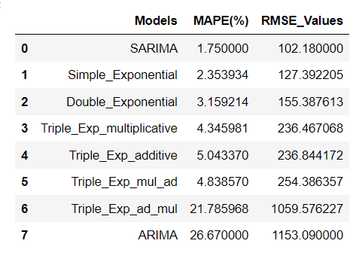
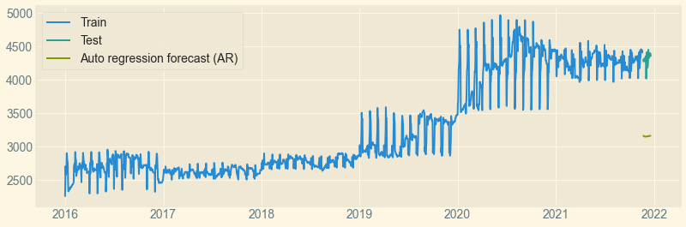
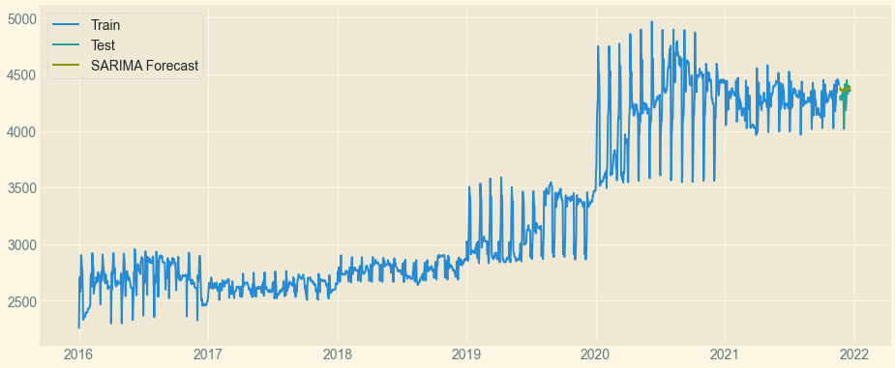
Model Evaluation With ARIMA & SARIMA:
Obeservations:
ARIMA model gives very bad results.
SARIMA works better and it also captures the trend and seasonality.
ARIMA model forecasting:
SARIMA model forecasting:
Observations:
ARIMA model performs very badly .
It’s forecast is far away from original validation dataset.
Observations:
SARIMA gives better result .
It also captures the trend & seasonality .
It gives lowest residual value as shown in chart.

Slide 11
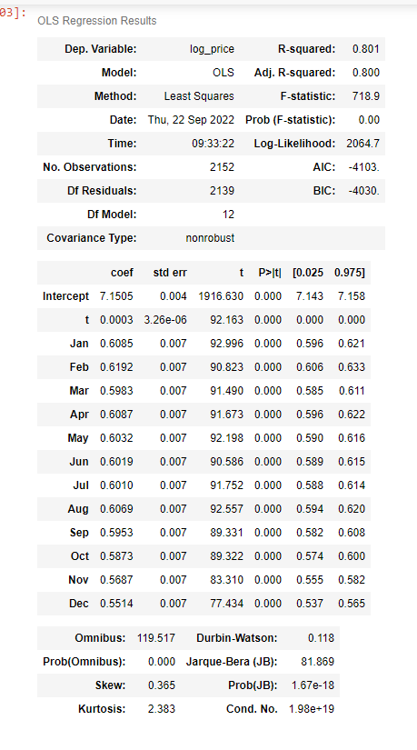
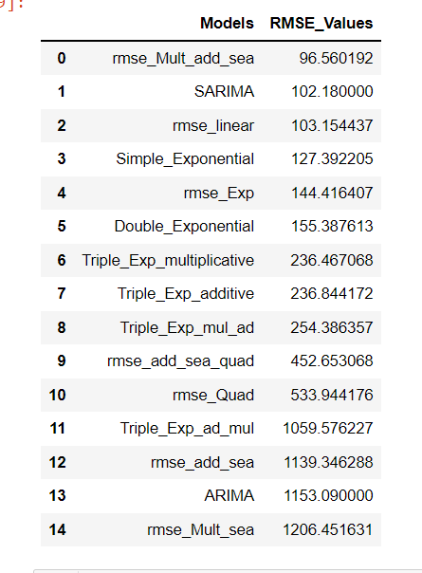
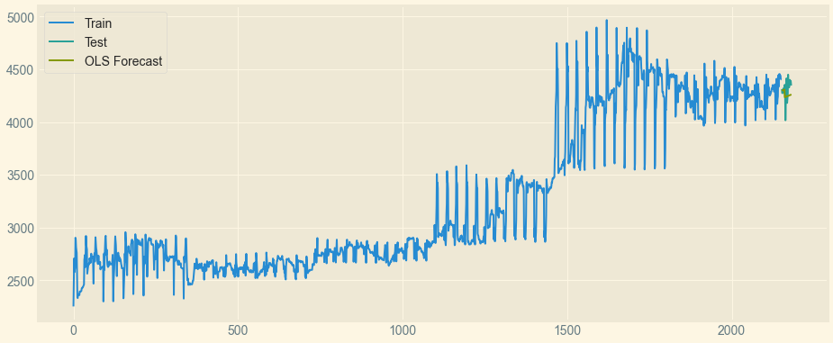
Model Evaluation Using OLS Regression Techniques:
OLS Regression Results:
Observations:
OLS regression model with trend & seasonality gives the lowest RMSE value .
Thus it provides proof for SARIMA model that dataset has trend & seasonality.
OLS Regression forecasting plot:

Slide 12
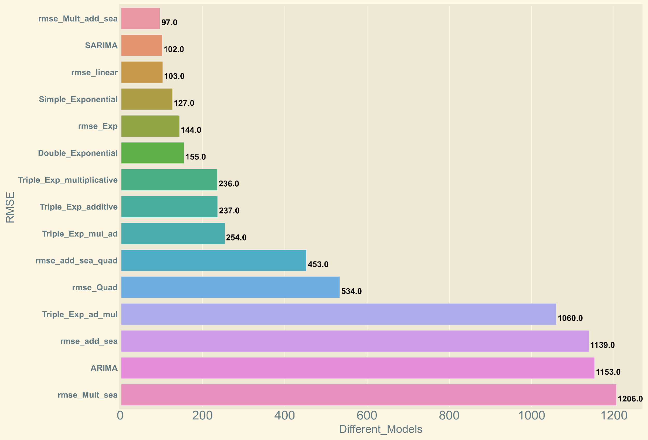
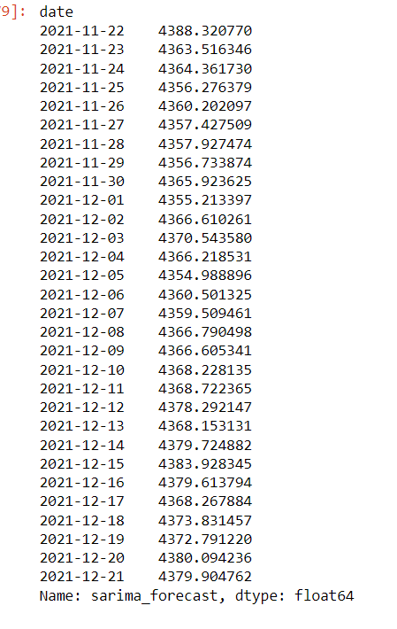
Summary of RMSE values with visual representation of all models:
SARIMA Model’s forecast Result for 30 days on validation dataset:

Slide 13
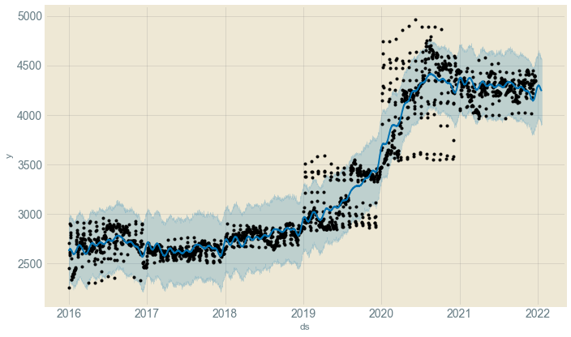
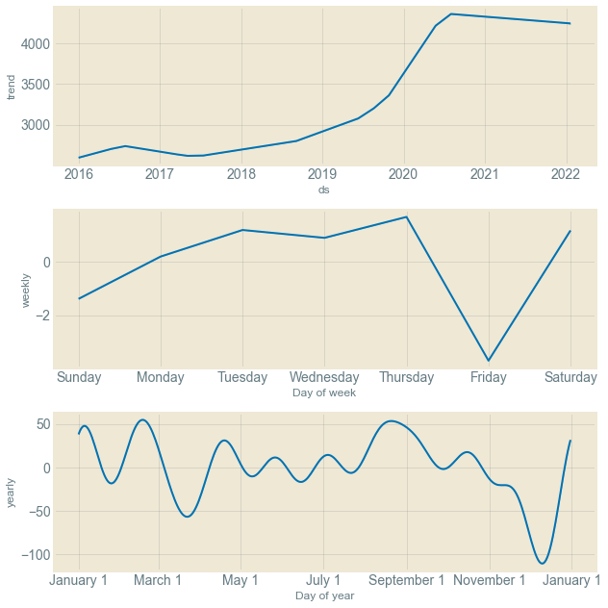
FBPROPHET Model for Forecasting Gold Prices:
Observations:
Here blue faint region shows the CI ( confidence Interval ) of the respective values.
Black point are actual datapoint values.
And Blue continuous line is related to forecasted values of the FBPROPHET model.
Thus it also gives the better forecasting result .
FbProphet model also shows weekly & yearly level trend.
In next slide , we have compaired these results with SARIMA models forecasted result values.

Slide 14
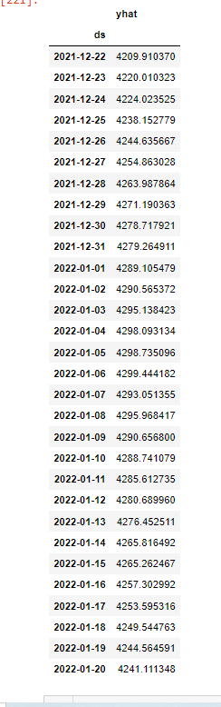
Comparison of forecasted values for 30 days of SARIMA & FBPROFHET Model:
SARIMA Model:
FBPROPHET Model:

Slide 15
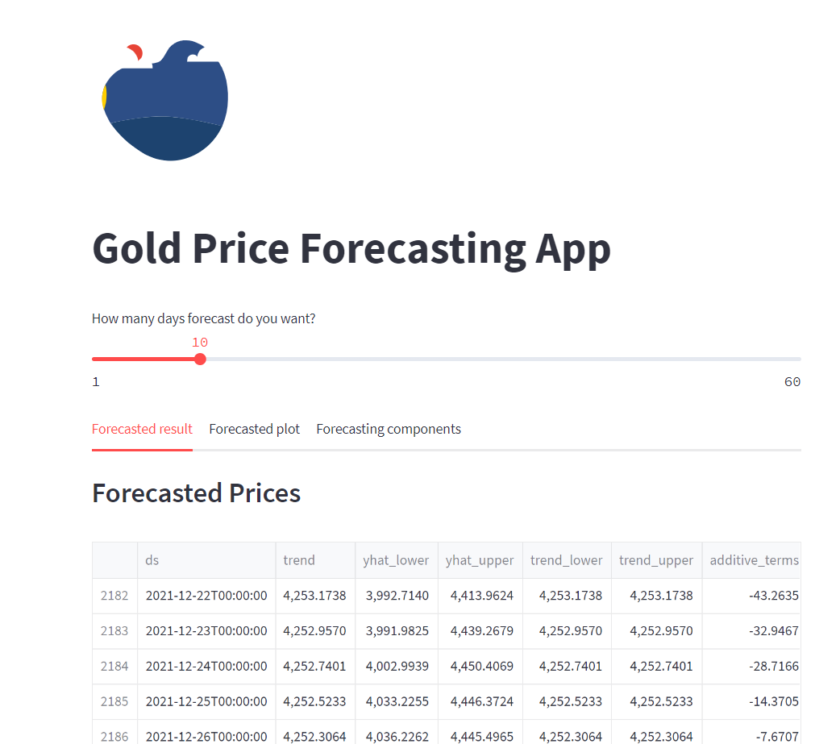
Model Deployment:- FB Prophet
Created a Web Application using IDE like VS Code.
FB Prophet is chosen for deployment.
Deployed a Web Application using Streamlit in Cloud Platform like Heroku.

Slide 16
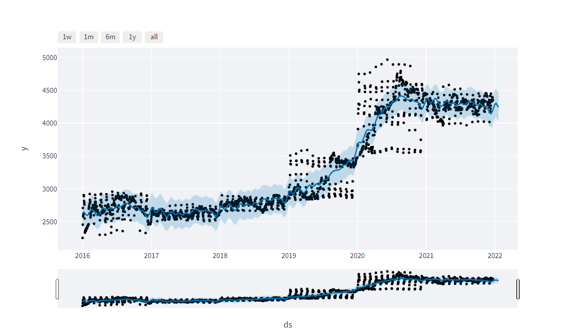
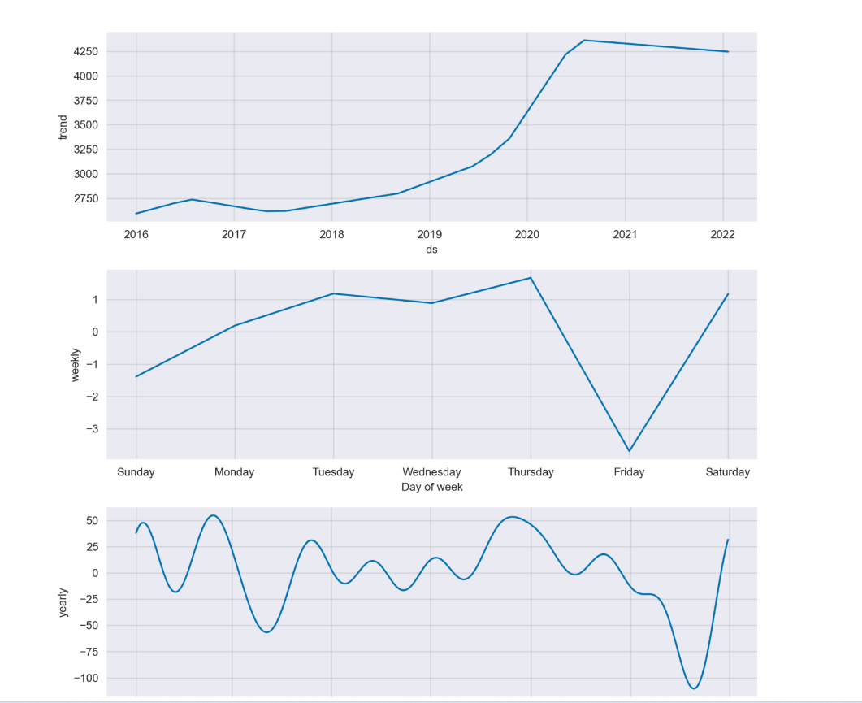
FB Prophet Model and Seasonality Interface

Slide 17
Problems Faced During Project
Data was not in stationary form. So we have converted data into stationary form.For that we used the these different log , square root , shift , difference functions techniques.
Because of transformations techniques used , we have to use the reverse transformation techniques to get the output in original format.
Hyperparameter tuning for models like ARIMA and SARIMA was tough task. So, we have done hyperparameter tuning by defining a function.
trend component was not uniform . At first , it was showing additive type of trend but due to corona pandemic , it was some like multiplicative type.
By watching the plot graph , it was unable to determine seasonality ,but by using decomposition plot , we reached ultimately at good one.

Slide 18
Thank you !

